Slide 1

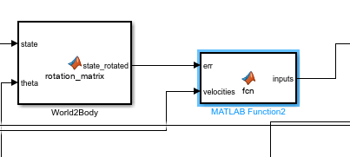
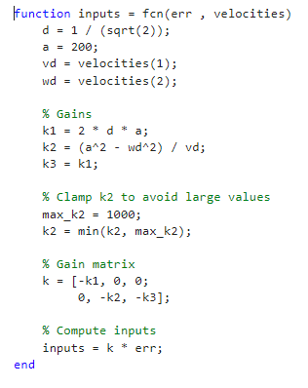

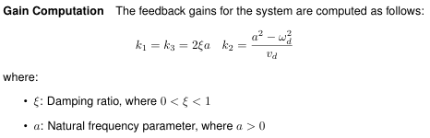
Controller design
saturation
persistent trajectories
TI
TV
no guarantee of asymptotic stability,
only for rectilinear and circular motion
Eigs allocation:

